Slide 1
Atomic Structure
Theories of the Nature of the Atom and Evidence for them.

Slide 2
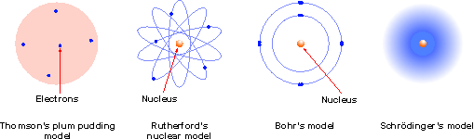
Historical development of atomic models
Atom is a tiny solid particle with electrons impregnated into the surface
Circular orbits containing electrons at specific energy levels
Orbitals – regions of space where the electron may be located. Electron is a particle withsome wave-like characteristics
Like a planetary system

Slide 3
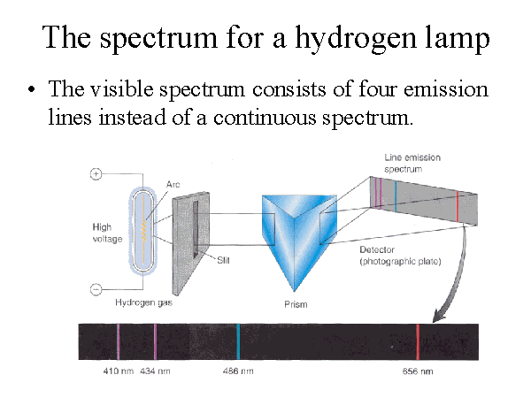

Slide 4
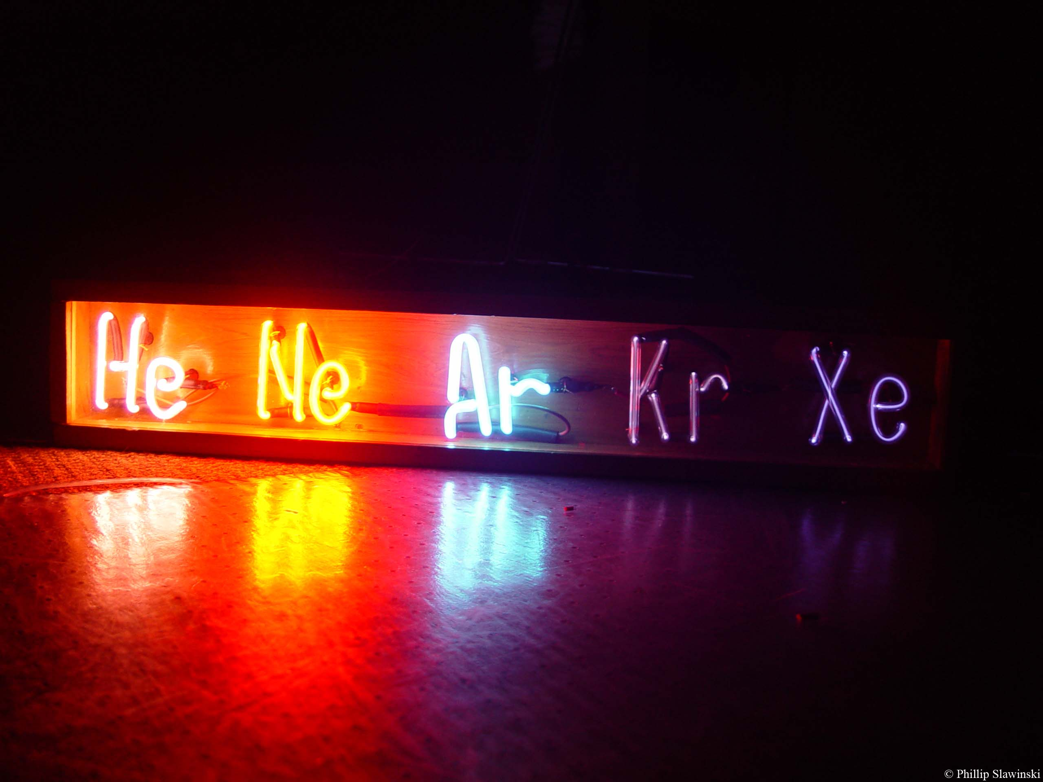
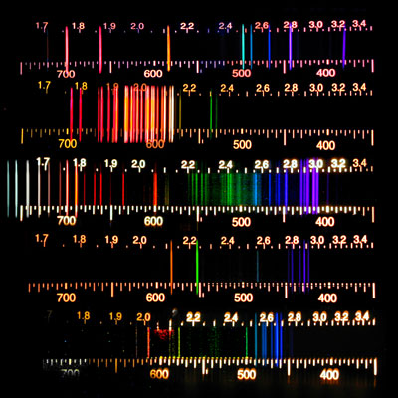
The lines observed in noble gas spectra clearly relate to the colours of their lighting tubes, once again explained by energy emissions from the atom as excited electrons return to ground state.

Slide 5

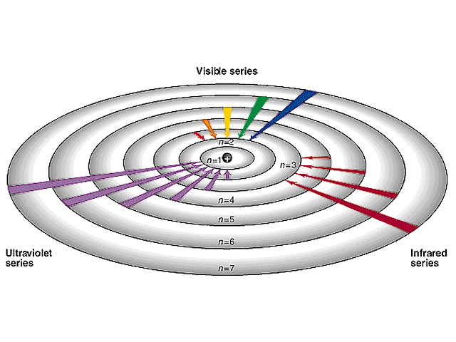
The lines observed in hydrogen spectrum (above) can be explained by energy emissions from the atom as excited electrons return to ground state.

Slide 6


Similarly other excited atoms also emit certain colours of light as their electrons return to the ground state.
The more colourful ones are used in fireworks.

Slide 7

Aren’t they pretty?

Slide 8
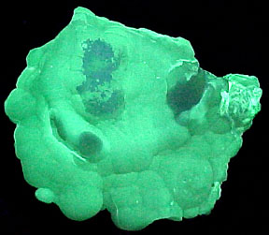
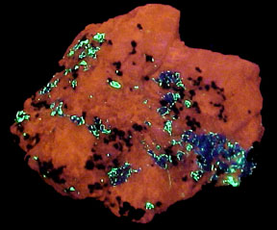
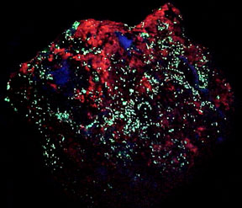
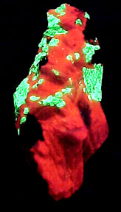
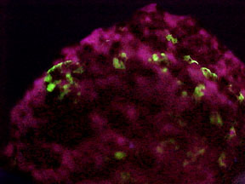
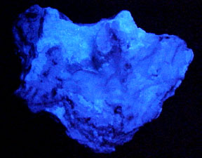
The fluorescence of some minerals in UV light can also be explained by the return of excited electrons back to their ground state.
Challenge Question : Why is visible light being emitted when the original source is a UV lamp?

Slide 9
Answer : The electrons receive the high energies of the UV rays and jump straight up to a highly excited state. However on return to the ground state they may return in a number of smaller steps – some of which may correspond to the energies of visible light.
Absorbed UV light
Emitted light

Slide 10
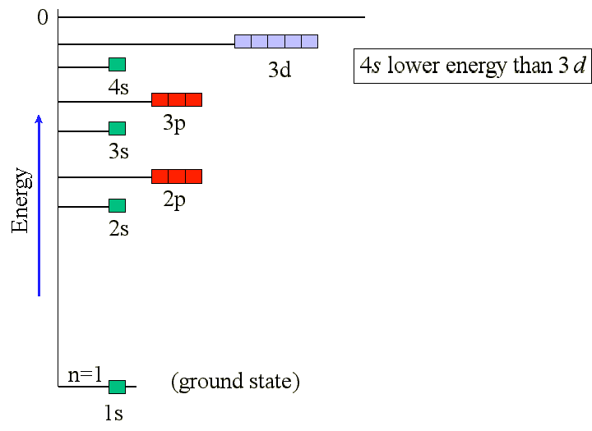
Electrons can be found in a number of Principle Energy Levels ; n = 1, 2, 3, etc.
These Principle Energy Levels contain a number of Energy Sublevels : s, p, d, f, etc.
Within the Energy Sublevels there are one or more Orbitals.
Each orbital can accommodate 2 electrons.

Slide 11
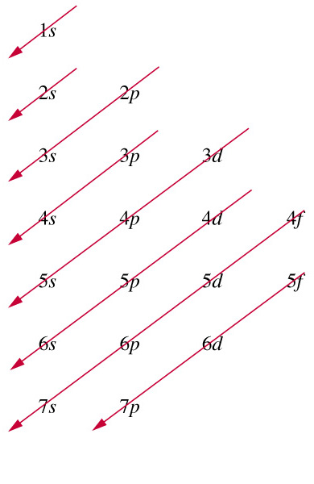
An electron configuration is a list of the locations of the electrons in an atom. The number of electrons to be allocated can be obtained from the atomic number on the periodic table. For ions the number of electrons needs to be adjusted accordingly. The order in which the energy sublevels fill is given by this arrow diagram.

Slide 12
Periodic Table/Electron Config. Link
- also shows elemental spectra
http://www.colorado.edu/physics/2000/applets/a2.html

Slide 13
Quantum Mechanical Model Link
http://mychemistrypage.future.easyspace.com/General/Atomic_Structure/Animations/QM_orbitals.html

Slide 14
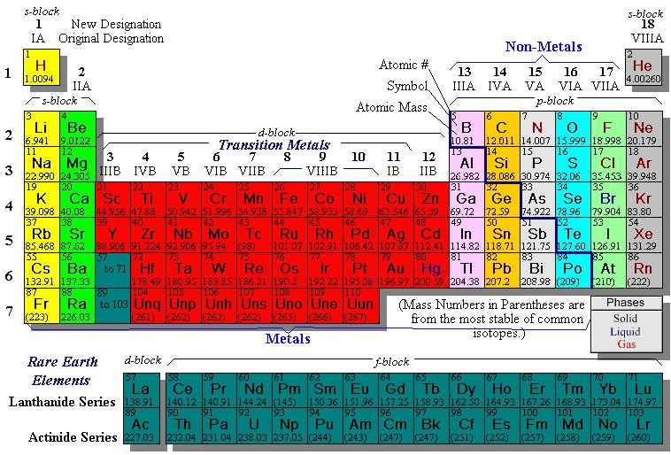
The Periodic Table is structured in blocks where atoms with similar valence (outer) electron configurations can be found.

Slide 15
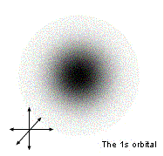
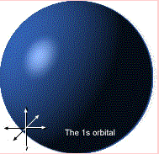
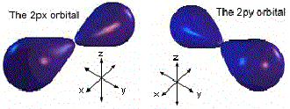
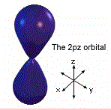
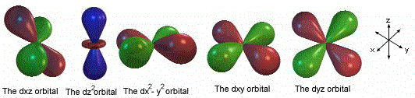
Some of the shapes of the orbitals as predicted by the Quantum Mechanical model
You do not need to learn these.

Slide 16
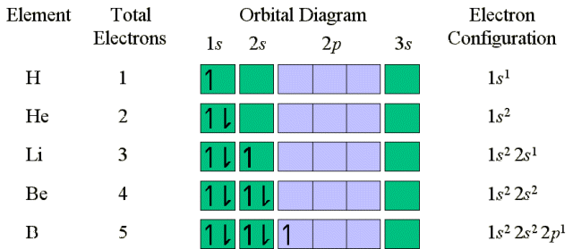
Orbital Diagrams show the number of electrons in each orbital. Each orbital can hold two electrons (Pauli Exclusion Principle). Arrows are used to represent these electrons, one pointing upwards(h) and one downwards (i) to indicate electrons spinning in opposite directions. Each orbital is represented by a box. Each orbital of equivalent energy must acquire an electron before any of them gain a second.

Slide 17
End of Slide Show
To Return to Year 12 Tutorial List
Choose Back from Menu above

